Slide 1

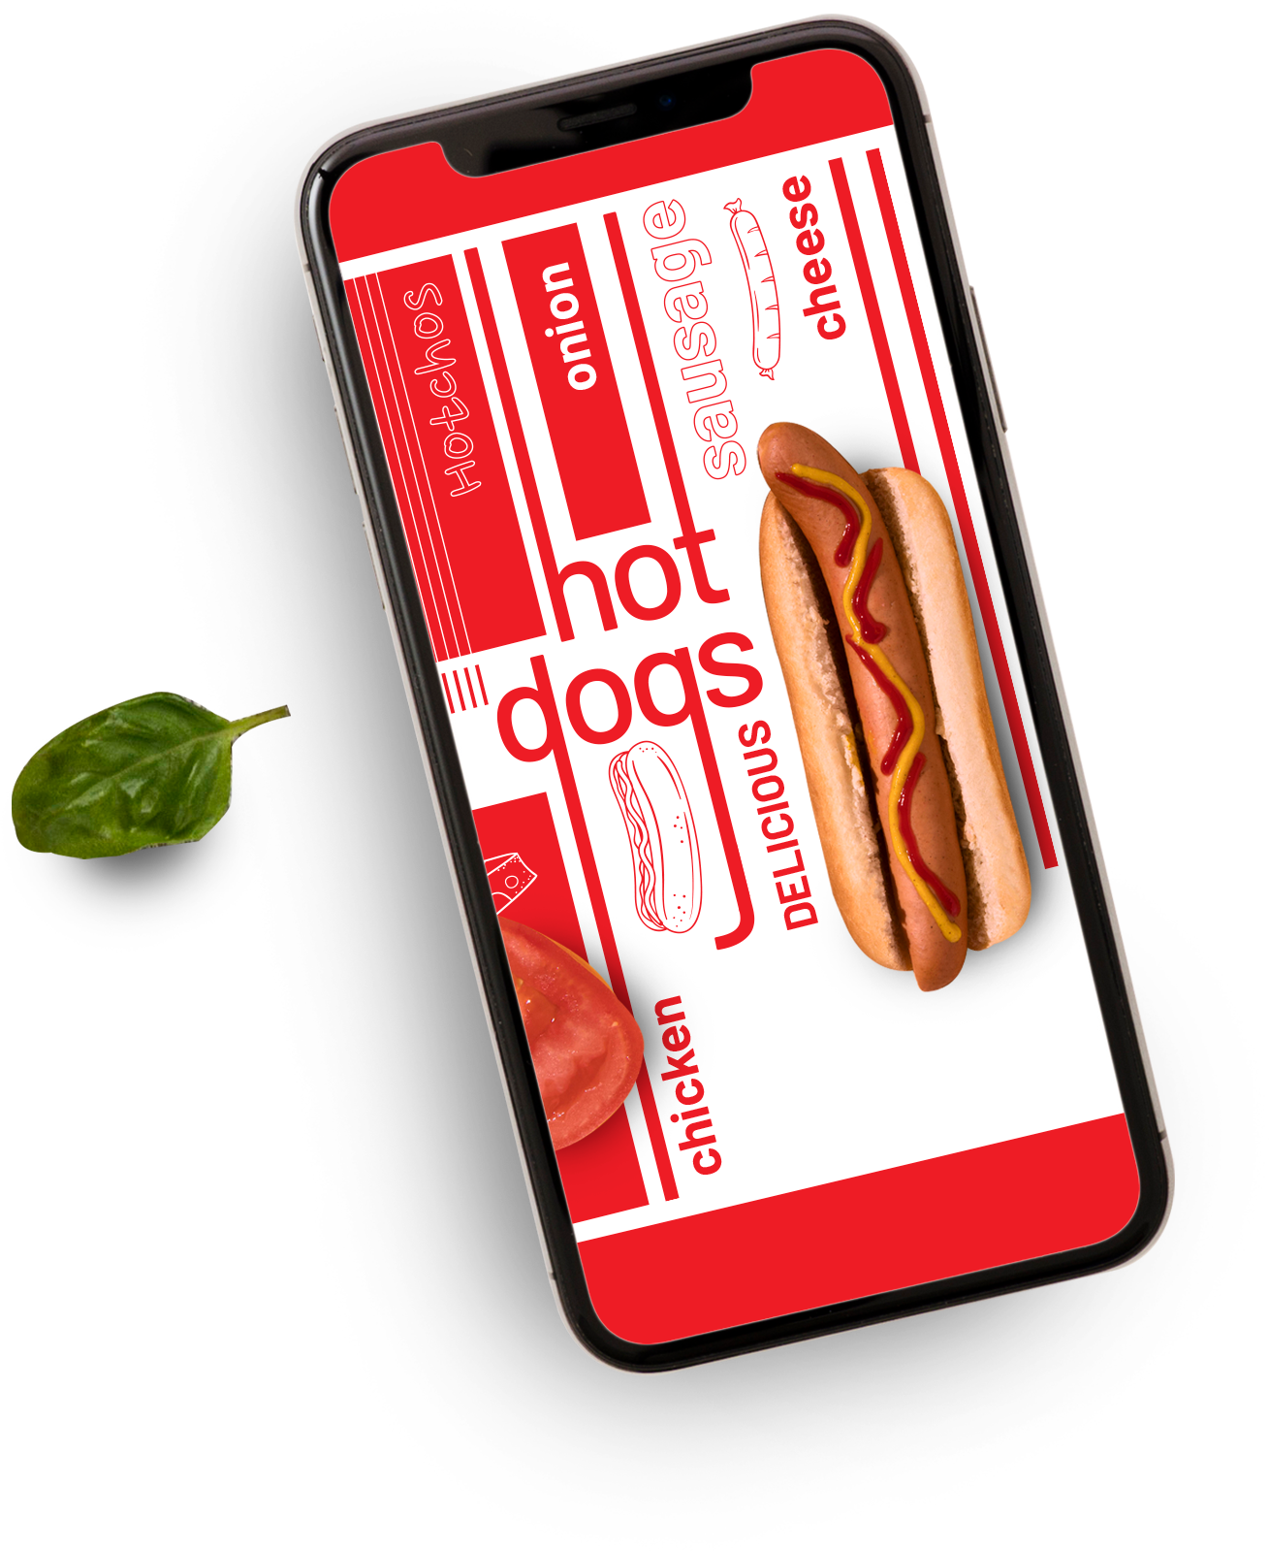




Zomato Sales Analysis
A Multi-Tool Data Insights Report
TEAM
Md Hanzalla Ansari hanzalla007@gmail.com | Sawarkar Sanket Mahoharrao sanketsawarkar058@gmail.com
Harsh Sahu harshsahu4677.hs93@gmail.com | Ganesh Shankar Chaudhari gchaudhary0123@gmail.com
Rahul Kacharu Phuke rahulphuke777@gmail.com | Sawant Siddhant Kumar sawantsiddhant045@gmail.com

Slide 2
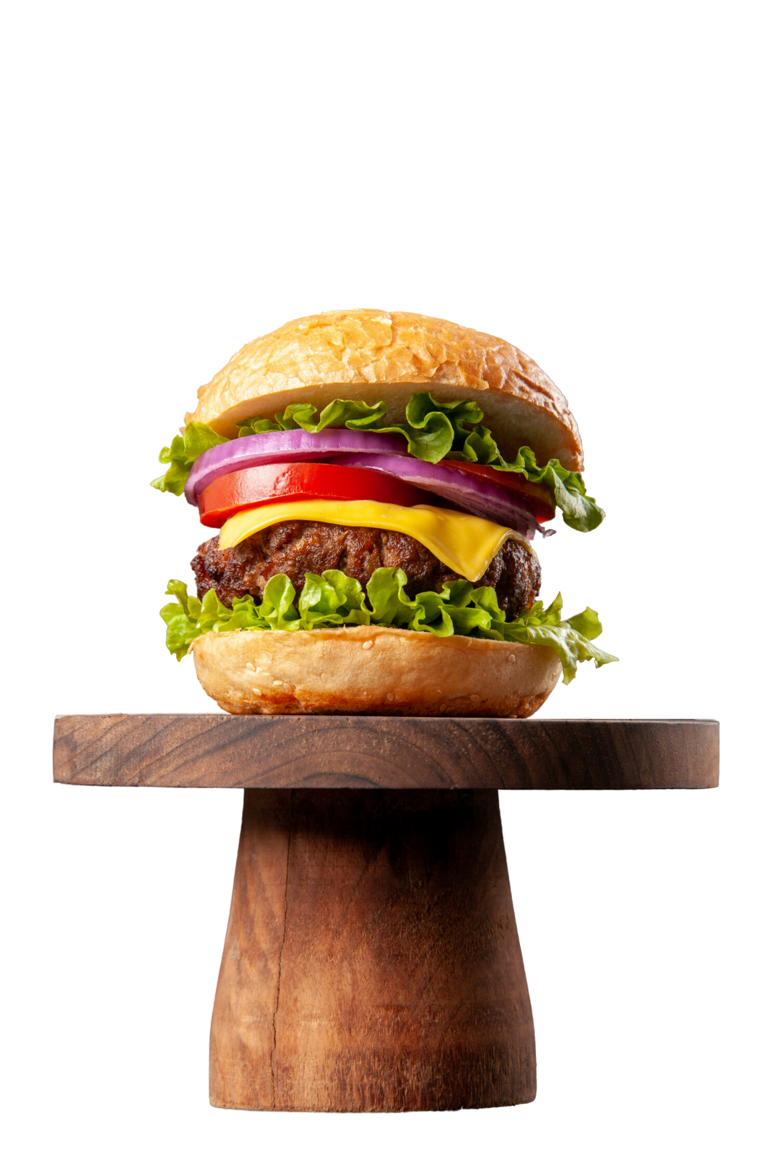
Table Of Contents
01
Introduction
02
KPI’s (3-11)
03
Dashboards – Excel, Power BI, Tableau (12-17)
04
SQL Query
05
Challenges Faced and the solutions
06
Conclusion

Slide 3



Introduction
Zomato is a popular online platform that helps users discover restaurants, read reviews, and order food online. With a vast amount of data on restaurants, user ratings, cuisines, and delivery services, analyzing this data offers deep insights into:
Customer preferences and dining behavior
Popular cuisines and pricing trends
Restaurant distribution across cities
Impact of online delivery services
This project aims to uncover meaningful patterns and trends in Zomato’s data to support strategic decisions for both restaurant owners and food enthusiasts.

Slide 4

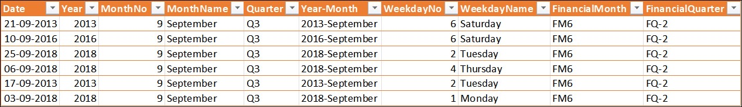
Calendar Table Creation
Objective: Time-based slicing using Datekey_Opening
Columns Created: Year, MonthNo, MonthFullName Quarter (Q1–Q4), YearMonth (YYYY-MMM) WeekdayNo, WeekdayName FinancialMonth (FM1–FM12), FinancialQuarter (FQ1–FQ4)
Inference:
The calendar table enabled dynamic time slicing—crucial for analyzing trends by year, month, quarter, and financial periods—laying the groundwork for all temporal insights in the project.

Slide 5
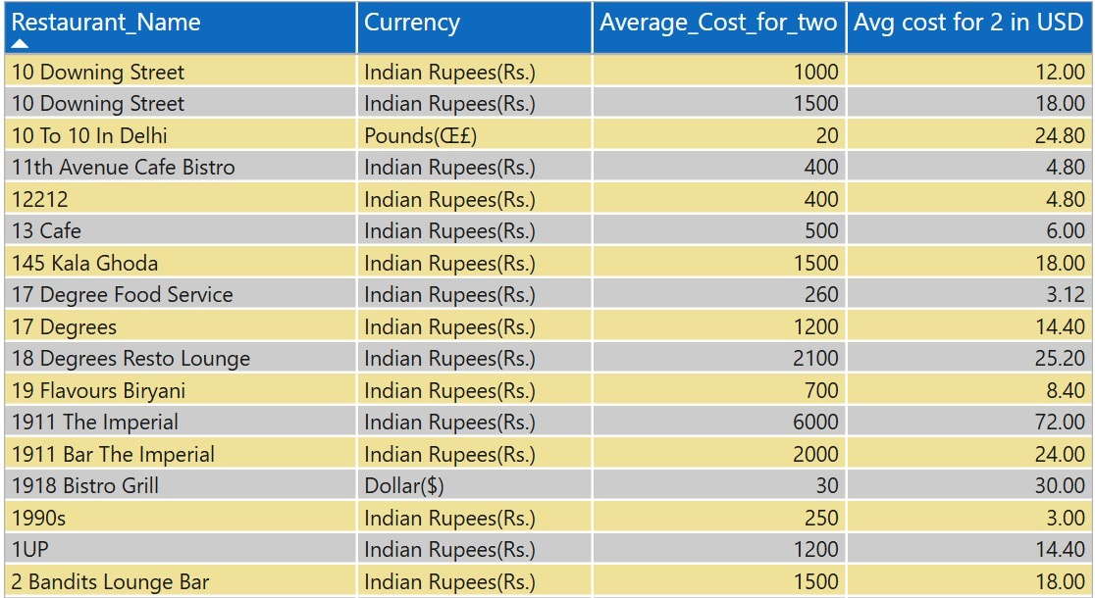
Currency Conversion
Objective: Convert "Average Cost for 2" to USD
Inference:
By converting all prices to USD, we made it easier to compare restaurant costs across different countries. This helped in understanding global pricing patterns more clearly and fairly.

Slide 6
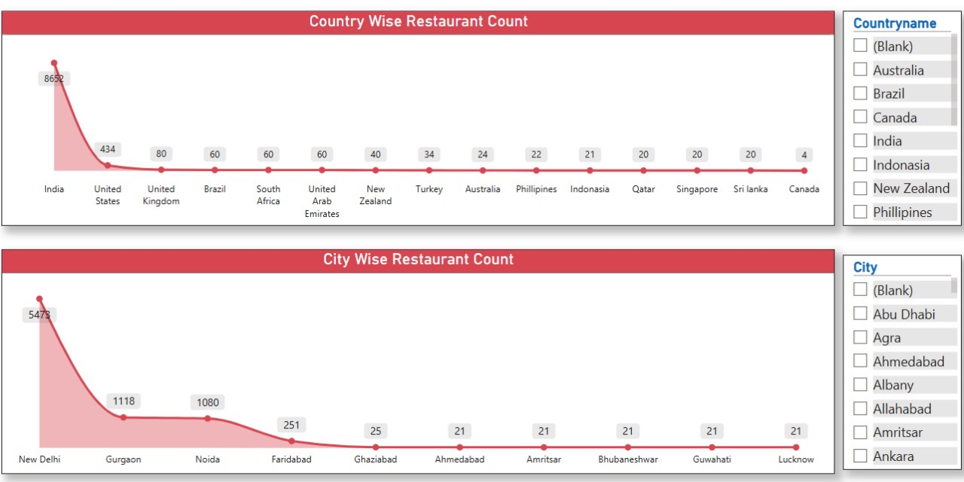
Restaurant Count by city/country
Objective: To identify cities with most restaurants
Inference:
Identifying the number of restaurants by city and country helped highlight key markets like Delhi, Gurgaon, and Noida, showing where Zomato has the strongest presence and potential for business focus.

Slide 7
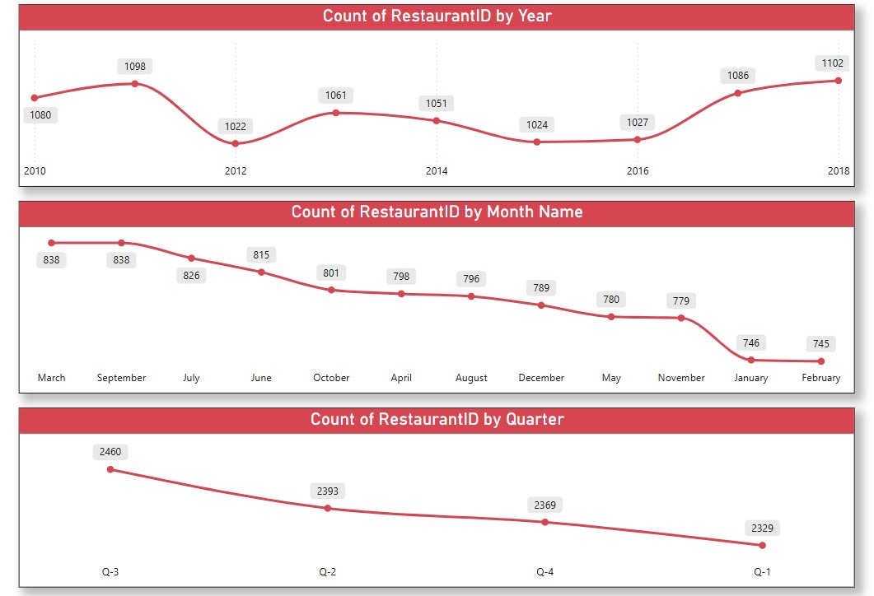
Number of restaurants opening by year, quarter and month
Objective: To analyze restaurant growth trends over time by breaking down openings by year, quarter, and month using the calendar table.
Inference:
The analysis revealed a strong upward trend in restaurant openings in 2018. Monthly – Highest counts in March and September. Quarterly- Q3 had the most restaurant activity.

Slide 8
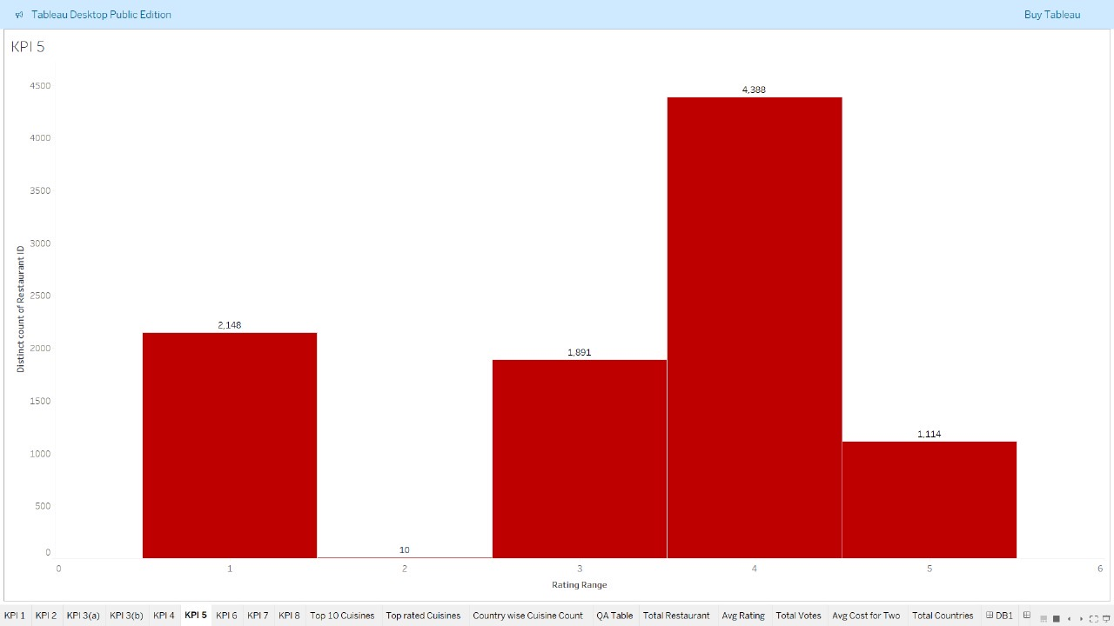
Count of restaurants based on average ratings
Objective: To categorize restaurants based on their customer ratings and understand the overall quality distribution across the platform.
Inference:
Most restaurants have ratings between 3 and 4, suggesting that while the majority maintain decent quality, few reach the highest rating tier—highlighting room for improvement in service or offerings.

Slide 9
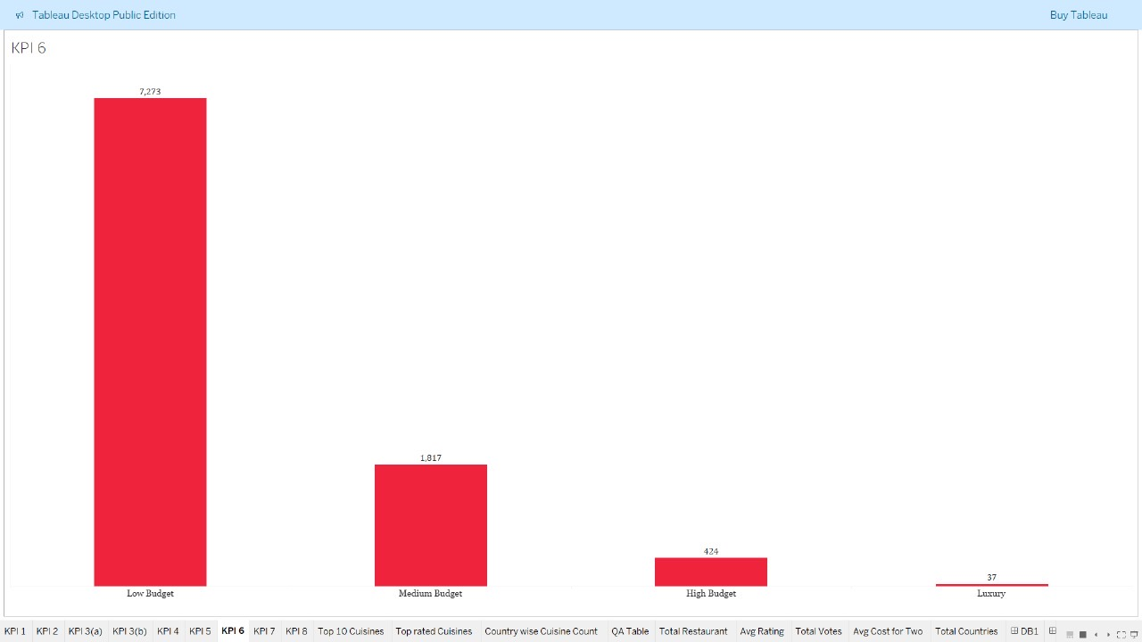
Price Bucketing
Objective: To group restaurants into price tiers and analyze how many fall into each category based on average cost for two people.
Inference:
Most restaurants are in the low and mid-range categories, showing that affordable dining options dominate the market, while high-end restaurants are relatively few.

Slide 10
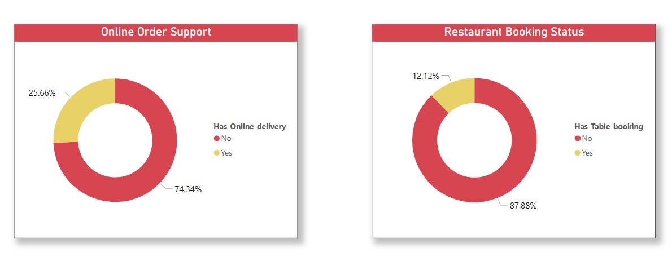
Percentage of restaurants with table booking and online delivery
Objective: To analyze the percentage of restaurants offering table booking and online delivery, two important features for customer convenience and service differentiation.
Inference: Online delivery : Only 25.66% support it
Table booking : Only 12.12% support it.
According to the data , most restaurants lack digital services

Slide 11
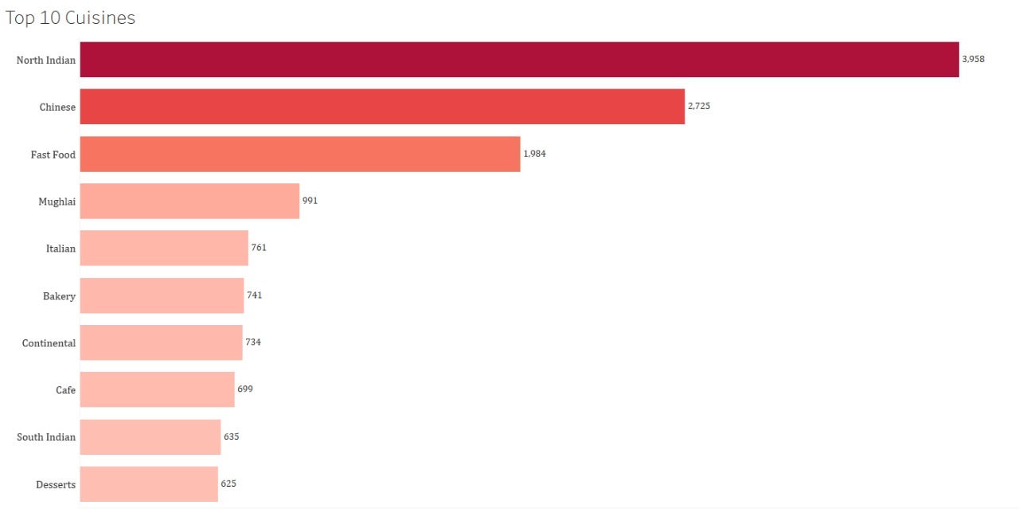
Top 10 most rated cuisines
Objective: To identify the top 10 cuisines with the highest number of customer ratings, giving insights into the most popular or frequently reviewed food types across platforms.
Inference:
The analysis highlights consumer preferences, with popular cuisines like North Indian, Chinese and Fast food dominating the ratings—indicating both high customer interest and wide availability.

Slide 12

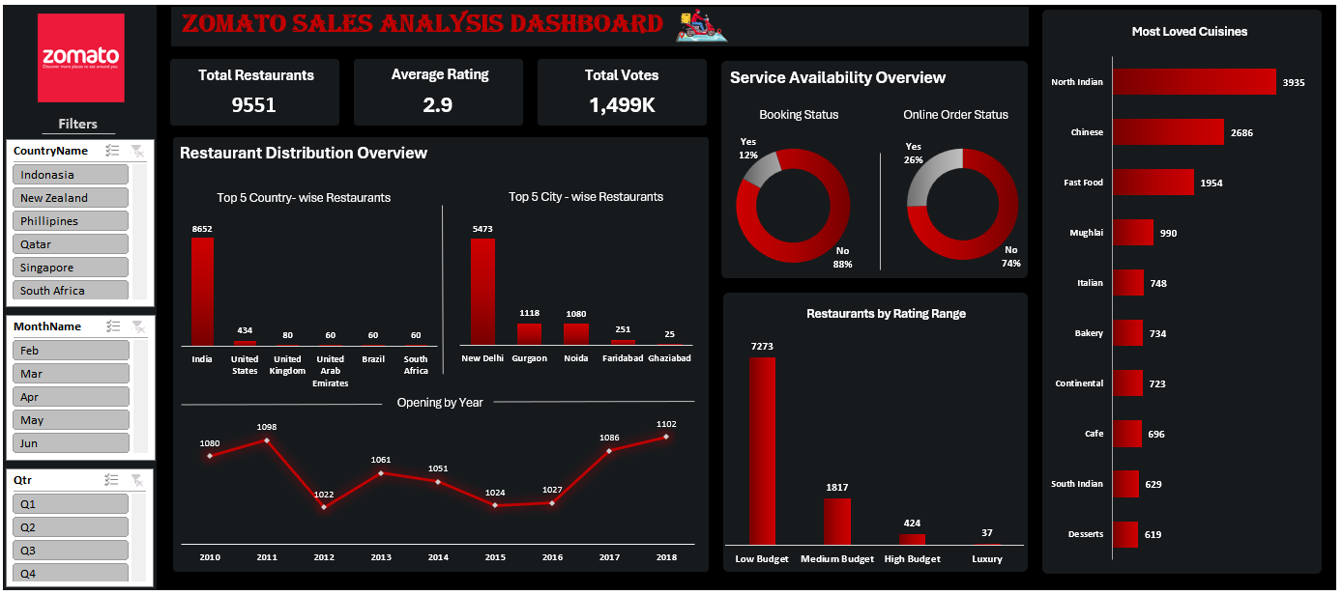
Excel Dashboard

Slide 13
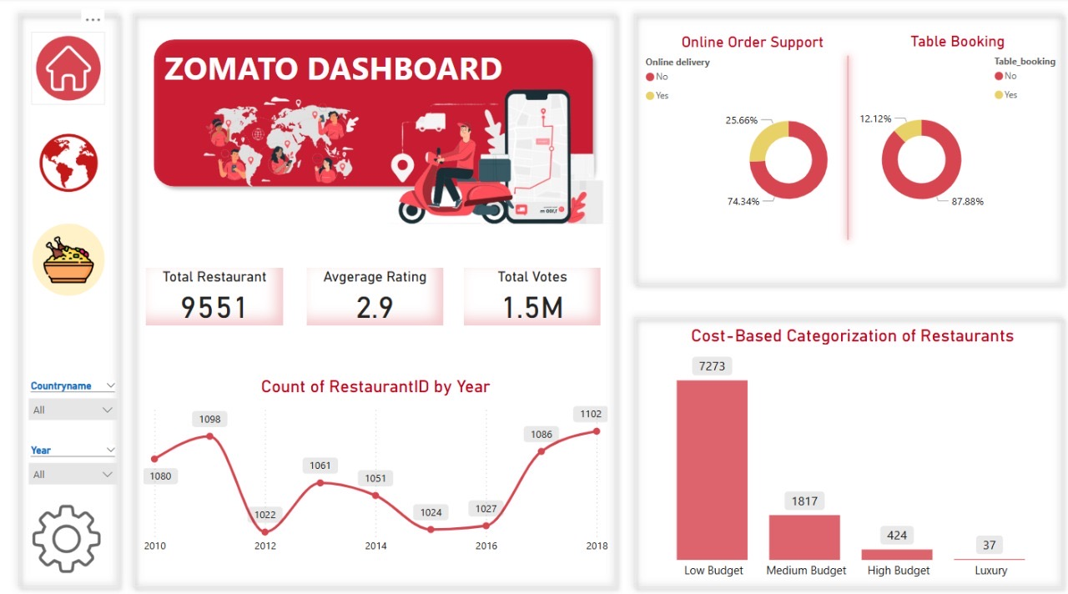
Power BI Dashboard

Slide 14
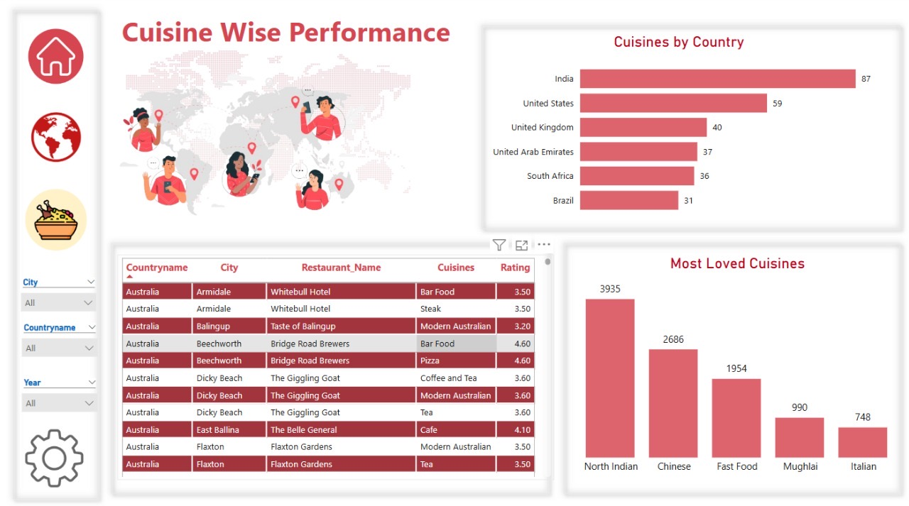
Power BI Dashboard

Slide 15
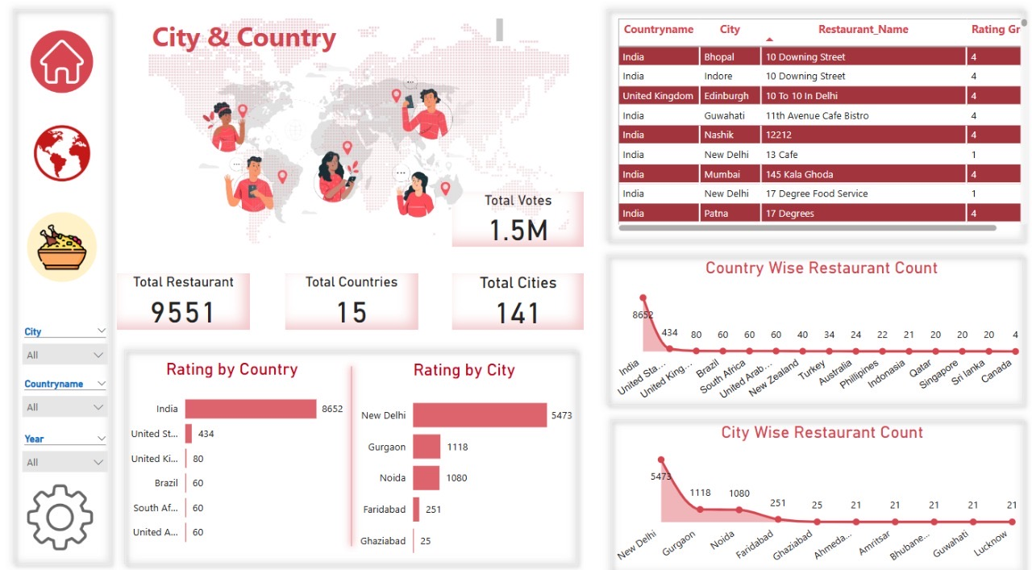
Power BI Dashboard

Slide 16
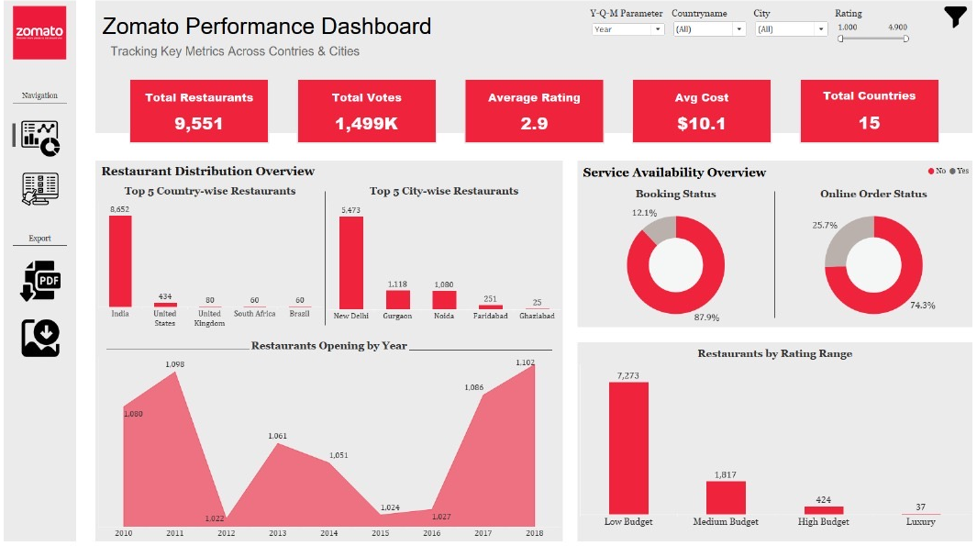
Tableau Dashboard

Slide 17
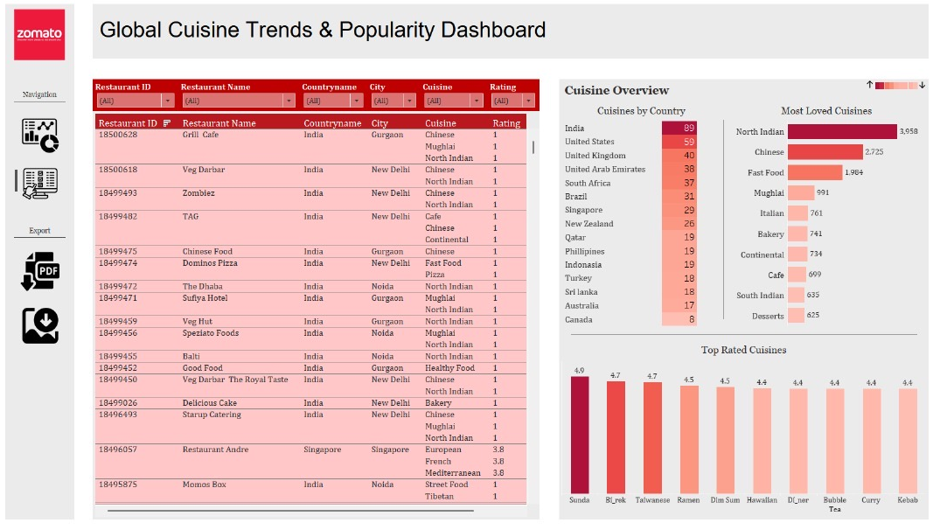
Tableau Dashboard

Slide 18
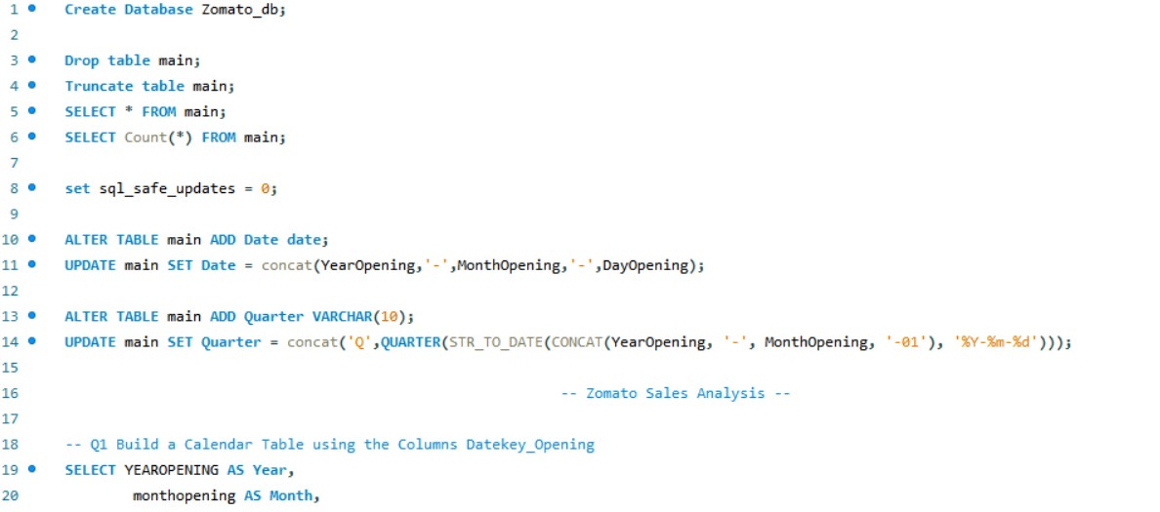
SQL Query

Slide 19
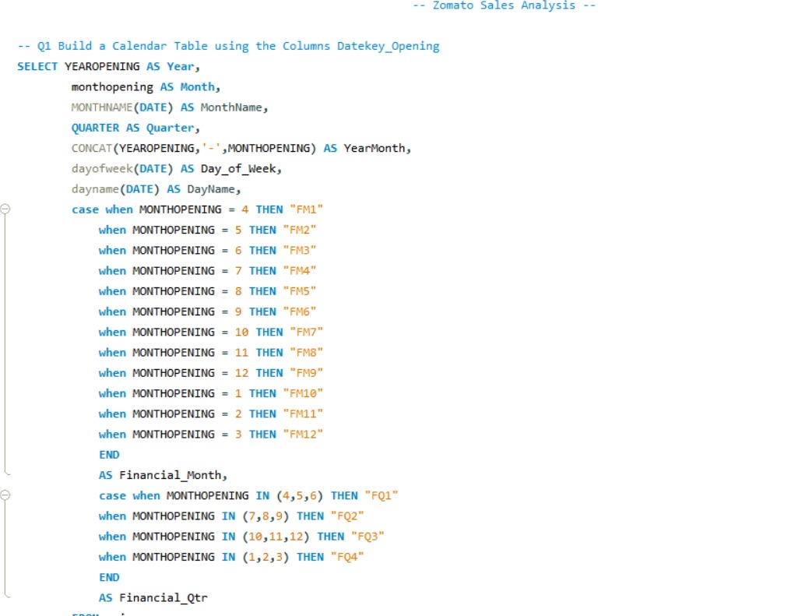
SQL Query

Slide 20
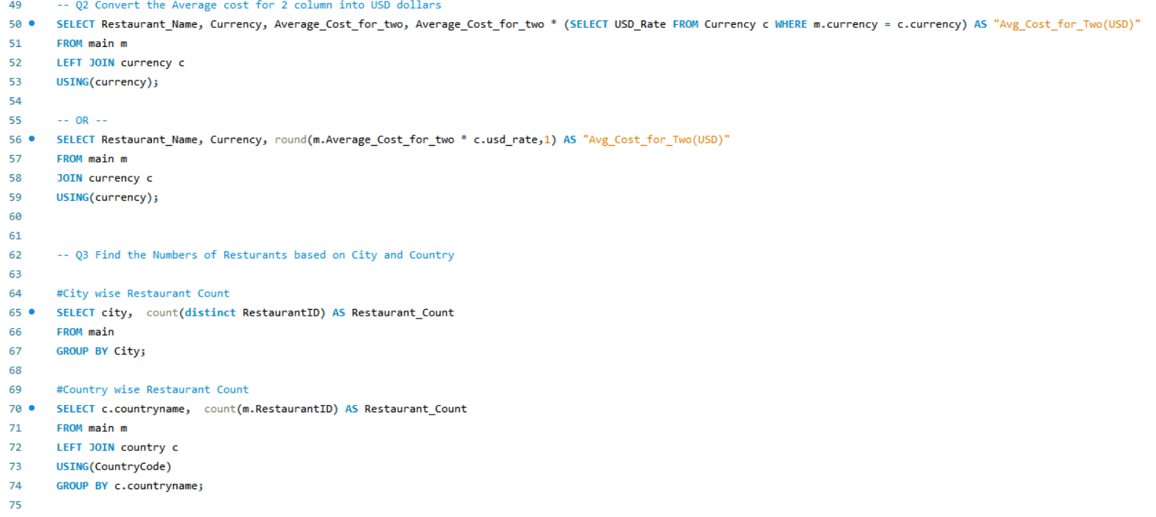
SQL Query

Slide 21
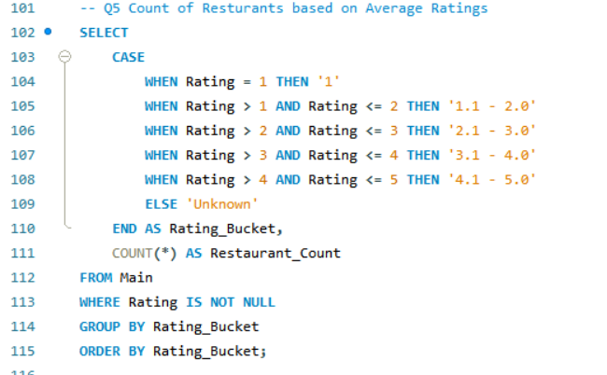
SQL Query

Slide 22
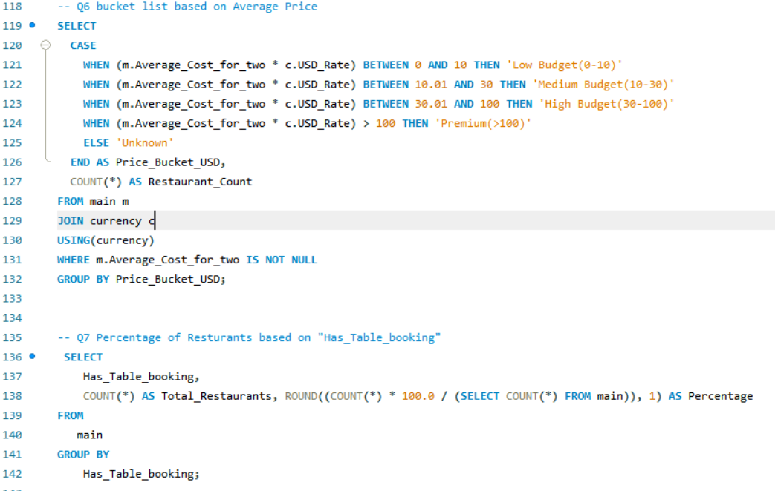
SQL Query

Slide 23
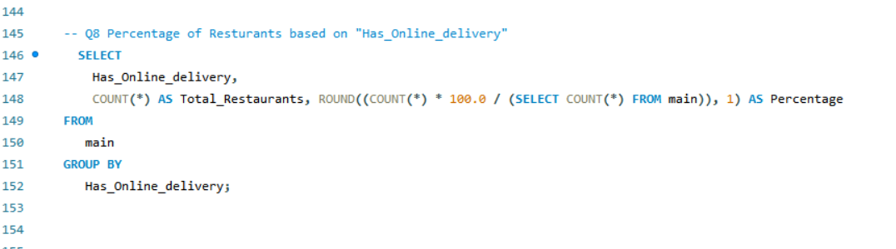
SQL Query

Slide 24

Challenges Faced and Solutions
Challenges | Solution
🌍 Different currencies across countries | ✅ Used a lookup table with conversion rates and applied logic to unify values in USD
📅 Financial months not in-built | ✅ Created custom logic using calculated columns (e.g., Financial Month, Financial Quarter)
⚠️ Null values in rating/cost columns | ✅ Cleaned data using Excel and SQL filters
🗓️ Inconsistent date formats | ✅ Applied STR_TO_DATE() and standardized date formatting

Slide 25
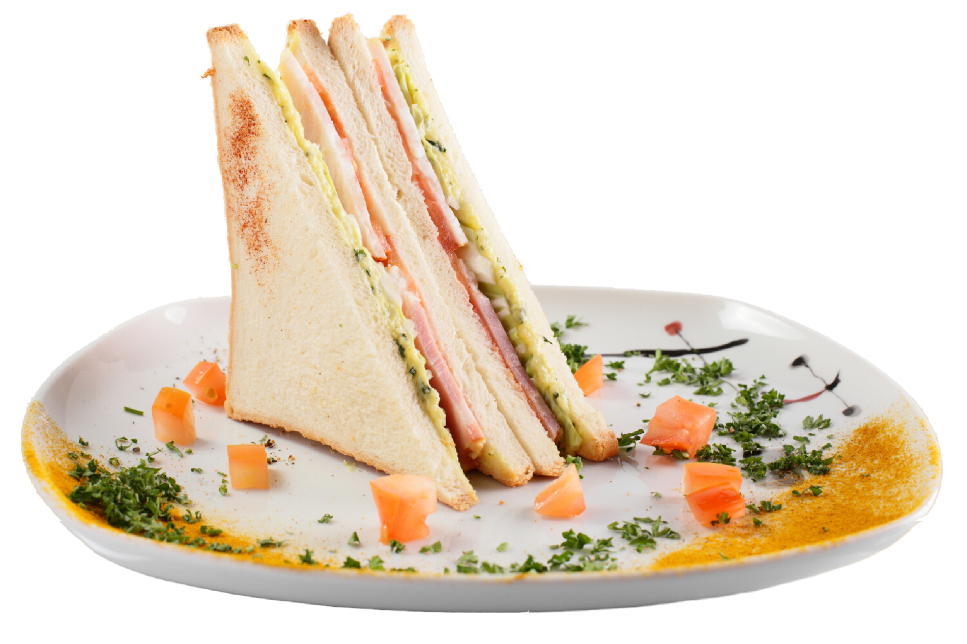
Key Take Aways From The Project
📌 A Unified, Data-Driven Journey Transformed raw restaurant data into actionable insights using Excel, SQL, Power BI, and Tableau — showcasing a full-stack analytical approach.
📈 Meaningful Insights, Real-World Value Analysed trends in cost, delivery, ratings, and regional growth — delivering insights that could drive strategic decisions in food-tech and hospitality.
🧠 Reflection on the Process Faced data inconsistencies, missing values, and model building challenges — but tackled them with structured thinking, teamwork, and technical execution.
🎓 Key Takeaway :This project reinforced the power of clean data, thoughtful questions, and visual storytelling in transforming information into impactful business decisions.

Slide 26





Conclusion: Insights That Drive Zomato’s Growth
Focus on Key Cities:
“Cities like Bangalore, Dubai, and Delhi are top performers. Prioritize marketing and logistics here.”
Boost Online Delivery:
“60%+ restaurants offer online delivery. Strengthen app features and delivery speed.”
Improve Table Booking :
“Table booking is underutilized. Partner with restaurants to expand this service.”
Optimize Pricing Strategy :
“Mid-range pricing dominates. Launch loyalty offers for each price tier.”
Promote High-Rated & Unique Cuisine :
“Highlight well-rated or niche restaurants to improve user trust and variety.”

Slide 27

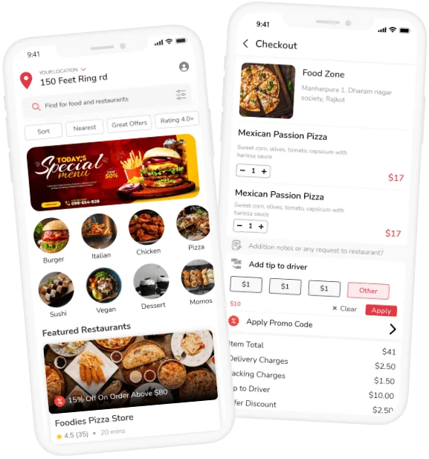
Thank You

